Slide 1
Java Basics 9
Guangjian Zhou

Slide 2
What are the implicit objects in JSP?
Object | Type
out | JspWriter
request | HttpServletRequest
response | HttpServletResponse
config | ServletConfig
application | ServletContext
session | HttpSession
pageContext | PageContext
page | Object
exception | Throwable

Slide 3
How will you extend JSP code?
<%@ page extends="your.java.class">

Slide 4
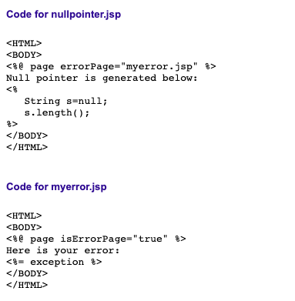
How will you handle runtime exceptions in JSP?

Slide 5
How will you prevent multiple submits of a page that come by clicking refresh button multiple times?
Using session

Slide 6
How will you implement a thread safe JSP page?
You can make your JSPs thread-safe by having them implement the SingleThreadModel interface. This is done by adding the directive <%@ page isThreadSafe=”false” %> within your JSP page

Slide 7
How will you include a static file in a JSP page?
< % @ include file="copyright.html" % >

Slide 8
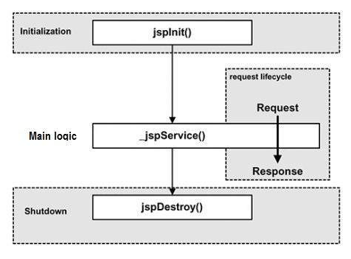
What are the lifecycle methods of a JSP?

Slide 9
What are the advantages of using JSP in web architecture?

Slide 10
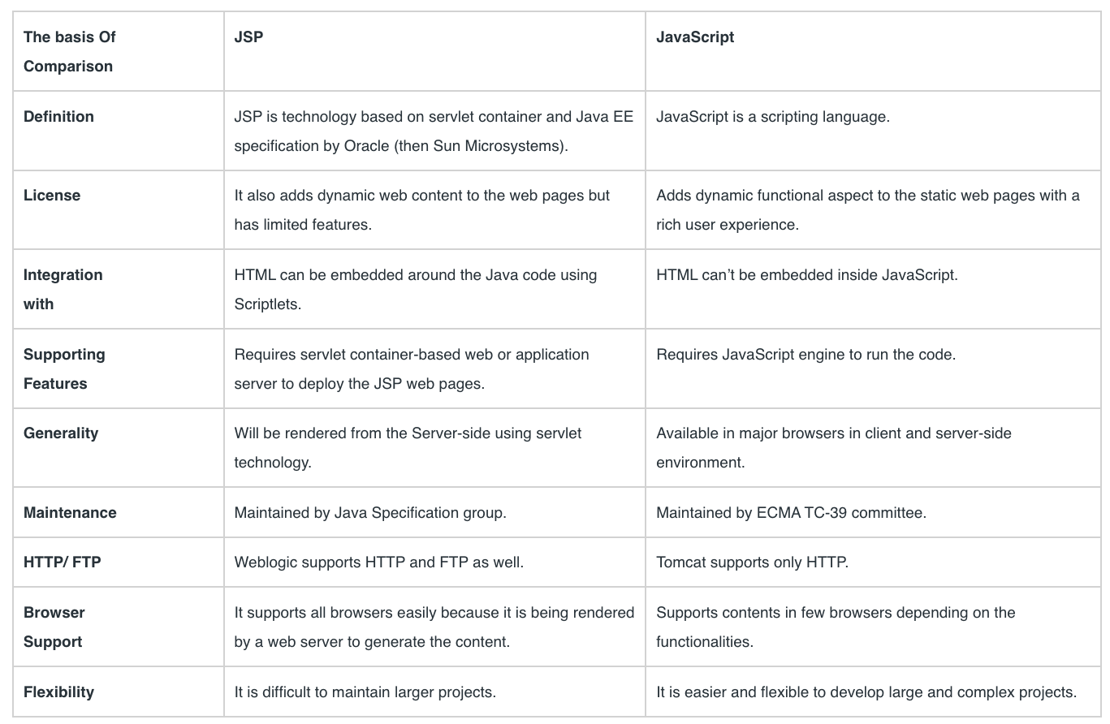
What is the advantage of JSP over Javascript?

Slide 11
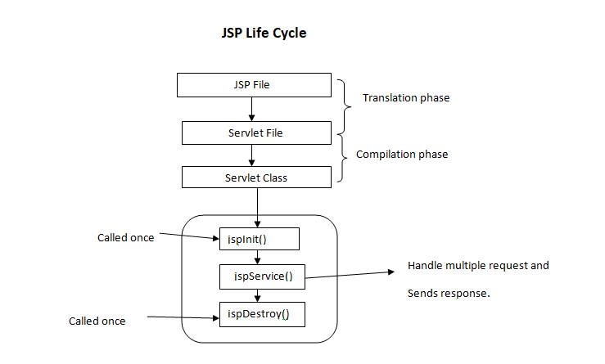
What is the Lifecycle of JSP?

Slide 12
What is a JSP expression?
A JSP expression is used to insert the value of a scripting language expression, converted into a string, into the data stream returned to the client.

Slide 13
What are the different types of directive tags in JSP?
page directive.
include directive.
taglib directive.

Slide 14
What is session attribute in JSP?
The session attribute indicates whether or not the JSP page uses HTTP sessions. A value of true means that the JSP page has access to a builtin session object and a value of false means that the JSP page cannot access the builtin session object.

Slide 15
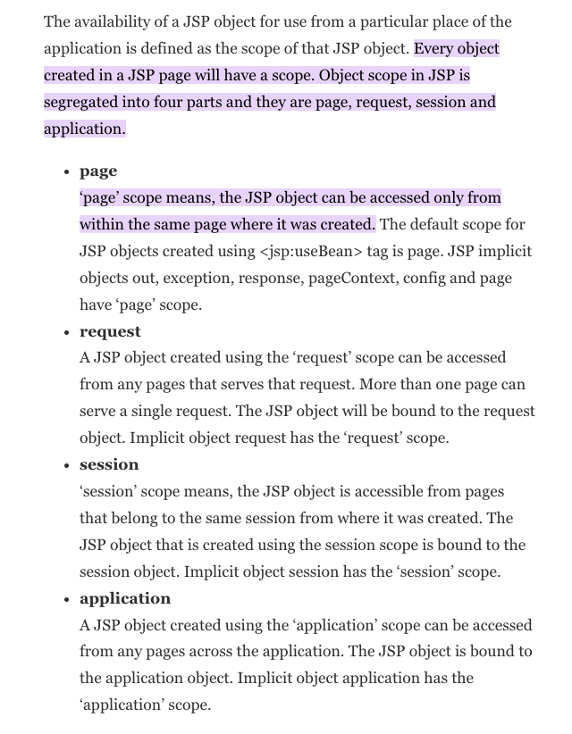
What are the different scopes of a JSP object?

